Slide 1
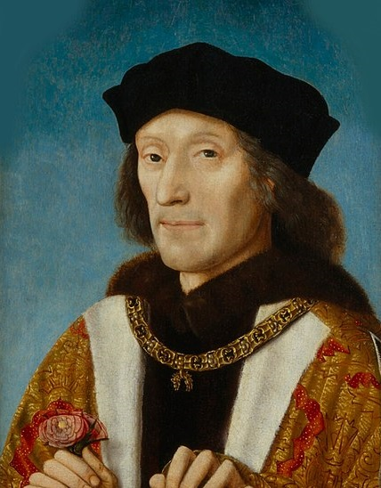
The Reign of Henry VII
How important was money in securing the throne 1485-1509?
An investigation of primary source materials relating to the reign of the first Tudor monarch.

Slide 2
Lesson 1: Objectives
To become familiar with Henry VII as a monarch and the nature of royal finance.
To consider our key question and the views of historians.
To introduce the Chamber Books as a resource and begin to look at them.

Slide 3
Bosworth, August 1485
Henry Tudor, the earl of Richmond, invaded through Wales and fought against the armies of the Yorkist king Richard III at Bosworth field. According to legend, after Richard was killed following a brave charge at Henry, the crown was found lying in a bush, from where it was taken and placed on Henry’s head by the rebel noble, lord Stanley.
Henry VII then proceeded to backdate his reign in Parliament to the day prior to the battle. He also hired an Italian academic named Polydore Vergil to write the history of England.

Slide 4
The Reign of Henry VII
Henry’s reign was framed by the fact that his claim to the throne had been weak but writers such as Vergil were hired to establish its strength.
Henry had to face 3 rebellions from supporters of the previous ruling dynasty. On two occasions these rebellions were based around pretenders to the throne wishing to replace him. Henry was also forced to deal with 2 tax rebellions at either end of the country in addition to the ruling of a growing country.

Slide 5
The Reign of Henry VII
The key question for us to investigate:
How important was money to securing the reign of Henry VII 1485-1509?

Slide 6
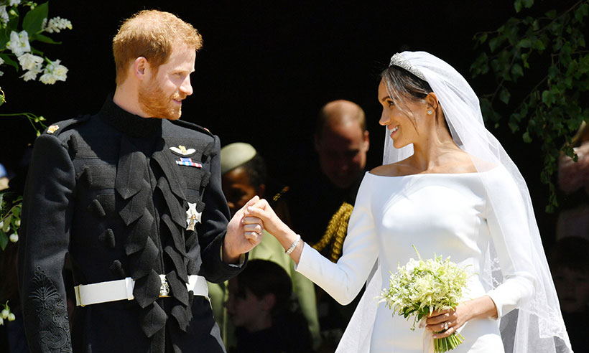
Who pays for a royal wedding?
How much did the wedding cost overall?
Can you guess the cost of the following:
Cake? Dress? Security? Private toilets for guests?
What is the Queen’s annual income?

Slide 7
Has this always been the case?
Yes. In 1504 Henry VII put a proposal before parliament for customary feudal dues, in other words traditional payments, to cover the cost of his son’s knighthood and his daughter’s marriage.
This wedding had been an extravagant event, with the bride wearing a gown trimmed with crimson and the banquet consisting of over fifty dishes. To the king’s surprise his appeal for money faced some opposition and he did not get the full funds he had asked for.

Slide 8
Royal Finances in late medieval England
Sound finances were an essential aspect of a stable monarchy. In an era when the personality of the monarch played a significant part in royal power, a poor handling of royal finances had already contributed to the removal of two kings, Richard II (1399) and Henry VI (1461).
Finances can be separated into income and expenditure. In terms of income, monarchs were wealthy landowners and could gain revenue from this, in addition they were often granted customs duties and the profits of justice (court fines).

Slide 9
Royal Finances in late medieval England
Expenditure fell into either the routine or exceptional. Routine expenditure would normally include such elements as defending the borders with Scotland and Wales and maintaining law and order. Exceptional spending could involve ceremonial expenses including weddings, significant additions to the royal household budget and alliances with other countries. If the monarch wanted to go to war, taxes had to be approved by Parliament and would normally be granted. By 1485, these would involve a negotiation in which Parliament would seek something in return for the grants.
As the collection of taxes was often slow and inefficient in places, the Yorkist Edward IV (1461-1483) changed the running of royal finances and controlled both the collection and spending of monies from the private royal chambers in a method labelled Chamber Finance. This method would be continued under the Tudor monarchs.

Slide 10
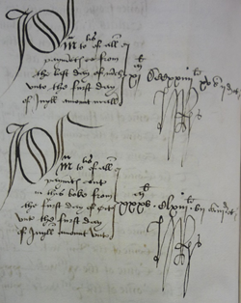
Henry and Finances
Henry’s reign is traditionally seen as the end of the Medieval period in England and he was keen to promote his reign as a break with the past.
England’s position in Europe was a vulnerable one. Therefore Henry secured a number of costly alliances to ensure his dynasty and used fines and bonds to keep the English nobility under his control.
He took a personal interest in government and financial policy. His signature appears on every membrane of the acts passed by his parliaments and he personally approved all of his own accounts.

Slide 11
Historians and Henry VII
You have 5 sources from historical books and articles regarding finances under Henry VII
Task
Read the excerpts on Henry.
Fill out the 3 columns on your sheet as you go through them.

Slide 12
Historians and Henry VII
Now… have a quick discussion in your groups considering the following questions
Do the historians have a view on Henry as an avaricious king?
How much importance do they give to money as a way of dealing with the nobility?
How much importance do they give to money as a way of ensuring domestic and international security?
What key quotes could we use to illustrate the views we have read?

Slide 13
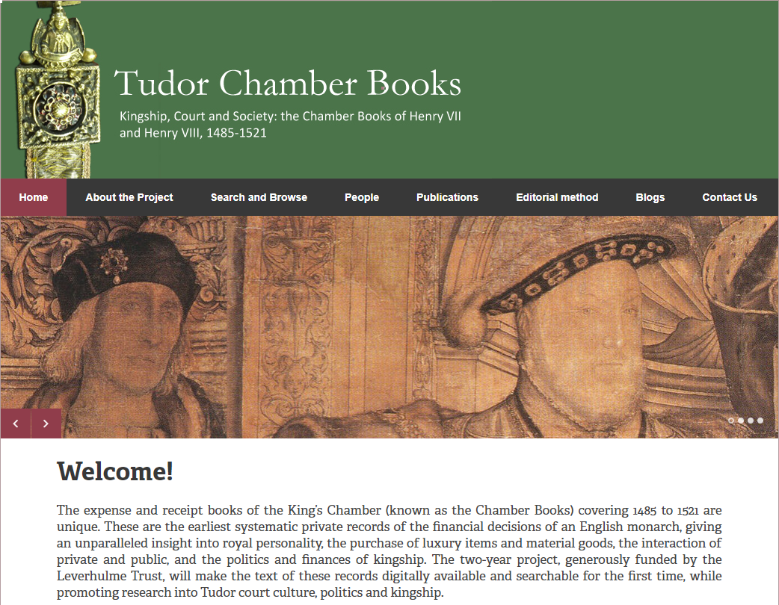
The project database enables us to look at receipts and other such records from the royal chambers of Henry VII and Henry VIII. We are going to use them to explore the reign of Henry VII.

Slide 14
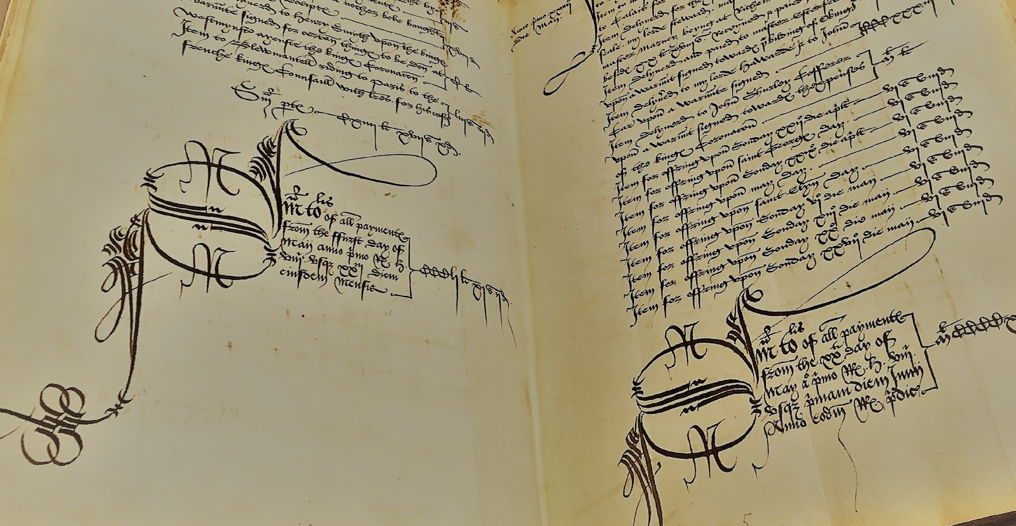
These handwritten accounts are a vital and priceless resource to historians of Tudor England.

Slide 15
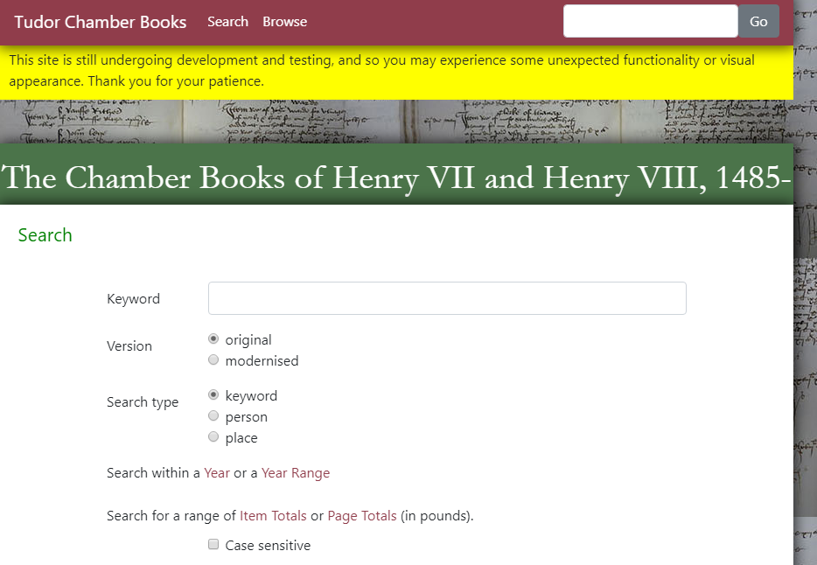
We will now go through how to search the database itself -
You will carry out a keyword search for the country ‘Wales’ using the instructions on your ‘How to Search the Database’ sheet.

Slide 16
Preparation for our next lesson
Go to the Chamber books project site
(https://www.tudorchamberbooks.org)
Search under the following keywords:
Loss (modernised, set the date range to 1485-1509)
Dice (original)
Tens (modernised)
Greyhounds (original)
Make a note of what you read (2 or 3 points for each search) and work out any amounts of money recorded in the books. Don’t be put off if you find any of the text confusing

