Slide 1
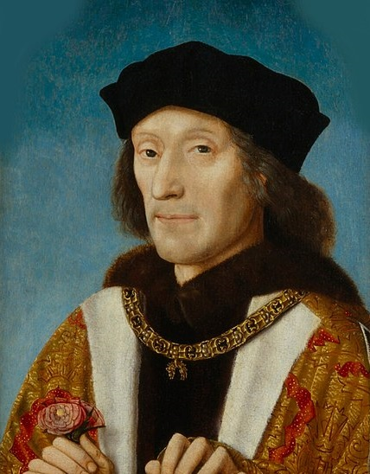
The Reign of Henry VII
How important was money in securing the throne 1485-1509?
An investigation of primary source materials relating to the reign of the first Tudor monarch.

Slide 2
Lesson 2: Objectives
To share our findings on Henry’s pastimes and monies he spent on them.
To investigate some cases using the manuscripts on the Chamber Books database.

Slide 3
Review of our homework

Slide 4
Your investigations: 1
Now divide into 3 research teams.
Team 1: Henry’s spending. Was he avaricious? What did he spend his money on?
Team 2: Henry’s control of money. What does an investigation into wardships tell us about Henry’s relationship with the nobles?
Team 3: Henry’s security. What do the chamber books tell us about how Henry VII kept himself secure from threats at home and abroad ?

Slide 5
Your investigations: 1
After you have finished your investigation, review your findings and complete the recording grid.

Slide 6
Your investigations: 2
Now divide up the more in depth investigations between you, in pairs or individuals.
Once completed, discuss and then record your findings on the recording grid.

Slide 7
Your investigations: 3
Plenary
Meet as a team and discuss your main findings.
Complete the ‘Review of findings’ section of your recording sheet.

Slide 8
The Reign of Henry VII
Returning to our key question
How important was money to securing the reign of Henry VII 1485-1509?

