Slide 1
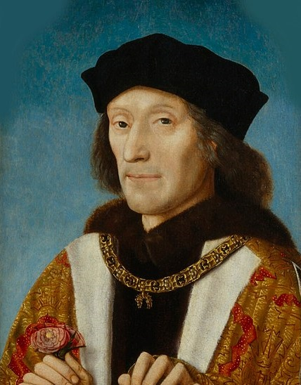
The Reign of Henry VII
How important was money in securing the throne 1485-1509?
An investigation of primary source materials relating to the reign of the first Tudor monarch.

Slide 2
Lesson 3: Objectives
To discuss our work to date and ease of using the Chamber Books as a resource on Henry VII
To display our findings and conclusions in a creative manner.

Slide 3
Discussions
What have we discovered with regards to:
Henry and his reputation for avarice?
Henry’s relations with the nobility?
How secure Henry felt on the throne?

Slide 4
Our task: The Henry VII documentary
We are going to use what we have taken from the last few lessons and planning a short documentary around our key question:
How important was money in securing the throne 1485-1509?
Firstly, we are going to watch a short excerpt from a documentary on Henry VII which features the chamber books.

Slide 5
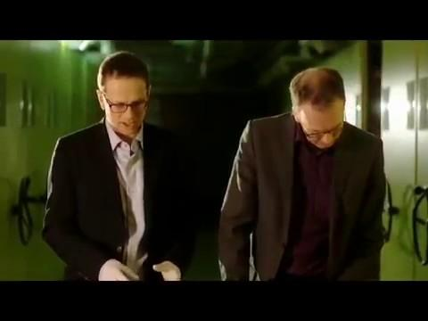

Slide 6
The documentary:
What must be included
An overall answer to the key question.
References to the three mini investigations.
How the Chamber books could be used.
The views of at least 3 of the historians you have encountered.

Slide 7
The documentary:
What to produce:
A script featuring all dialogue to be spoken
A basic storyboard illustrating how each shot should be framed.
A list of all your logistical needs: (i.e.) how many people?, what source images you would like?, venues for filming?
Could you use animation rather than live action? Would you like to use recreations with actors?

Slide 8
Overall conclusions
If you needed to write a detailed paragraph for an essay on how Henry remained secure and the role played by money.
What key points could you include?
What evidence could you refer to?
Could you mention the Chamber books?
Historians’ views?

