Slide 1
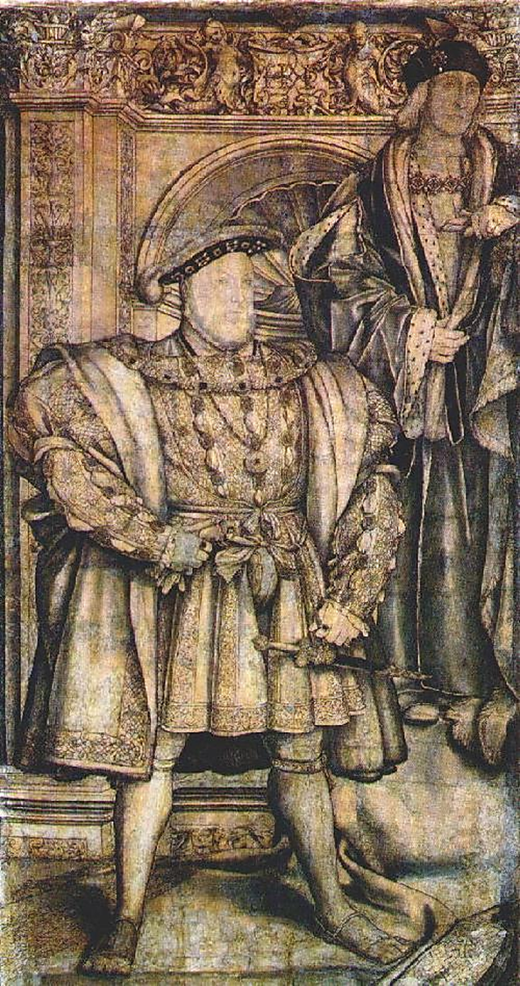
The Palaeography of the Chamber Books of Henry VII and Henry VIII – Introduction and Tutorial 1
Dr James Ross, University of Winchester
James.Ross@Winchester.ac.uk

Slide 2
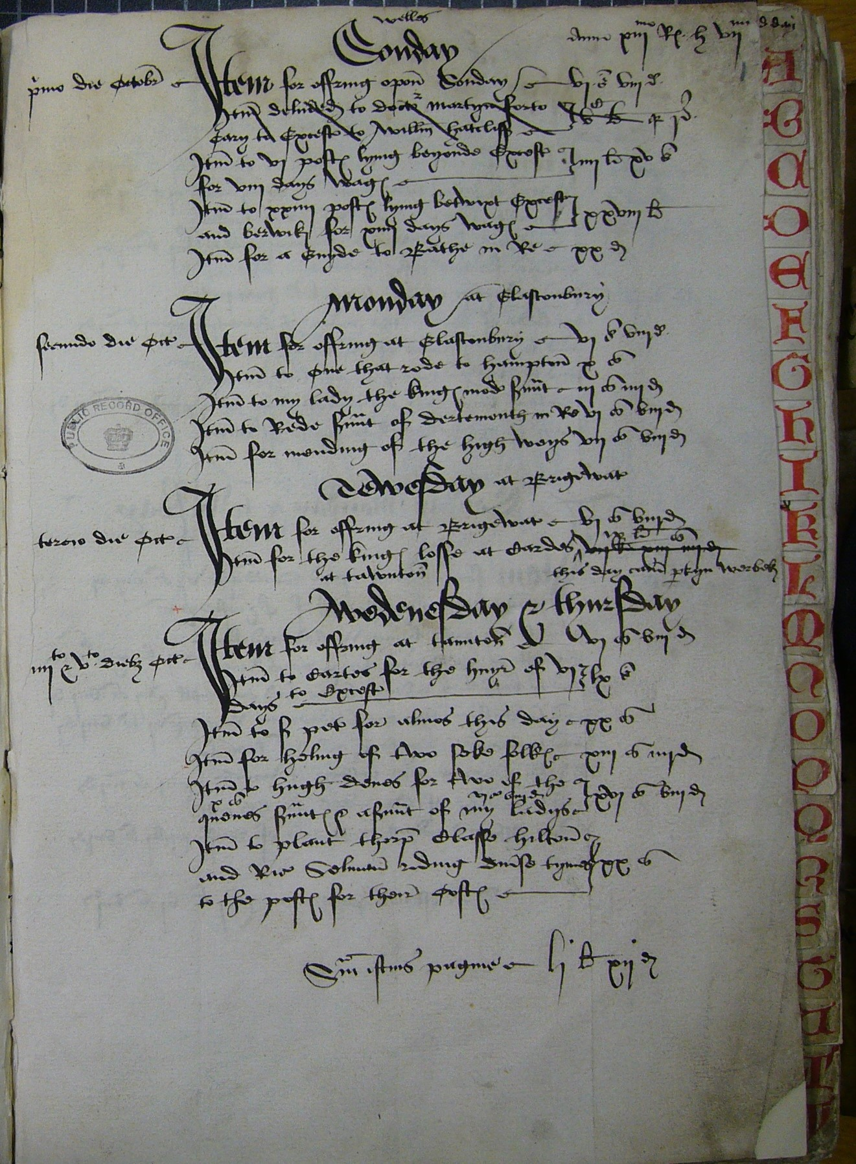
payment pages of the Chamber book for 1-5 October 1497
The National Archives, E101/414/16, folio 1r.

